Slide 1
Files and Exceptions

Slide 2
File
Files are suitable for storing results that are needed for an extended period of time, and for holding input values for a programme that will run several times.
Files are classified as text file or binary file
Text files: Can only contains characters using an encoding system such as ASCII and UTF-8. can be viewed and modified using any text editor.
Binary files: sequence of bits. Can contain any type of data, not just characters. E.g. images, sound, videos.

Slide 3

Opening a File
A file must be opened before data values can be read from it and before new data values are written to it.
Files are opened by calling the open() function.
The open() function takes two arguments: The string that contains the name of the file and the string that indicates the access mode for the file.
Access modes: read (denoted by “r”), write (denoted by “w”) and append (denoted by “a”)
A file object is returned by the open function.
Once a file is opened, methods can be applied to the file object to read data from the file or to write data to the file.
The file should be closed once all of the values have been read or written using the close() function.

Slide 4
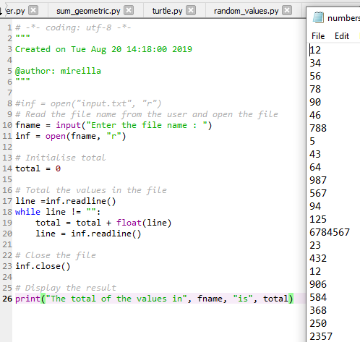

Reading Input from a File
Our list: numbers
Use "r" when you want to read an existing file without modifying it.
The readline() method reads one line from the file and returns it as a string, much like the input function reads a line of text typed on the keyboard.
readline () returns an empty string when there is no further data to read from the file.

Slide 5
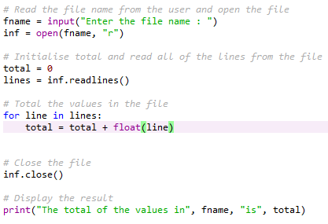
Reading Input from a File
Sometimes it is helpful to read all of the data from the file instead of reading one line at a time.
The read() method or the readlines method can help accomplish that.
The read() method will return the entire content of the file as one string – further processing is required to break the string into smaller pieces
The readlines() method returns a list where each element is one line from the file. Once all the lines have been read, a loop can be used to process each element in the list.

Slide 6
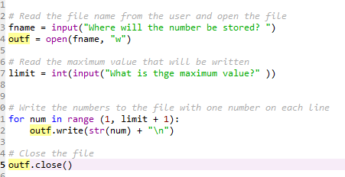
Writing Output to a File
When a file is opened in write mode, a new empty file is created
So, if that file already exists, then it will be deleted, and all data in it will be lost.
Open an existing file in append mode to write data at the end of that file.
If the file opened in append mode does not exist, then a new file will be created.
The write() method can be used to write data opened either in write mode or append mode. (In brief, write() expects a string and does not add a newline automatically.)
It takes one argument, a string. Convert other value types to a string using the str() function.
Unlike the print() method, the write() method does not automatically move to the next line. \n denotes end of line marker.
This programme writes the numbers from 1 up to (including) a number entered by the user to a file

Slide 7
Reading and Writing to a .csv File
.CSV (Comma Separated Values) is associated with importing and exporting spreadsheets and databases.
Allows greater control over data
When opening a .csv file, you must specify how that file will be used. The options are:
Code | Description
‘w’ | Creates a new file and writes to that file. If the file already exist, a new file will be created, overwriting the existing file
‘x’ | Creates a new file and writes to that file. If the file already exits, the programme will crash rather than overwriting it.
‘r’ | Opens for reading only and will not allow you to make any changes.
‘a’ | Opens for writing, appending to the end of the file

Slide 8
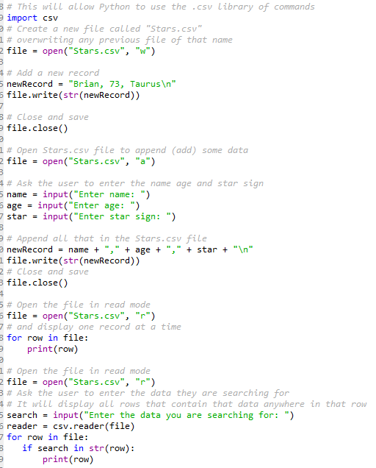

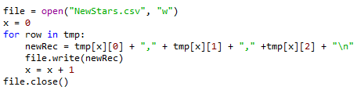
Reading and Writing to a .csv File
CSV files are plain-text files containing tabular data. You can read, overwrite, or append to them. To change an existing row safely, a common approach is to read the data, modify it in memory, and rewrite the file. If you need to alter the file, write to a temporary list. This code reads the original file and write it to a list called “tmp”
Writes from a list to a new csv file called “NewStars.csv”

Slide 9
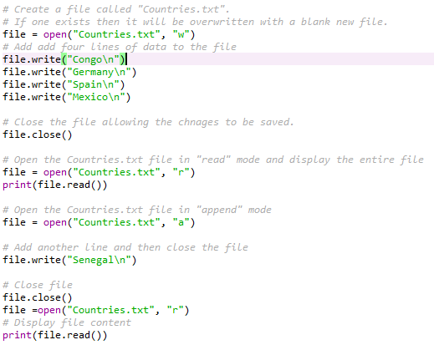
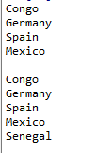
More code example - Writing and reading
The file.close() function at the end of the code tells Python the task of creating or reading is complete.

Slide 10
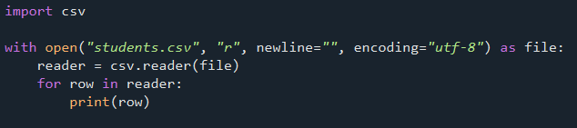
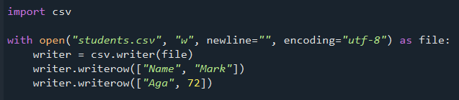
Python’s CSV module for reading and writing

Slide 11
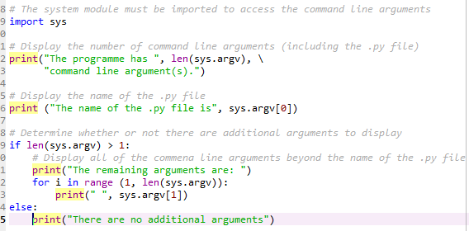

Command Line Arguments
Being able to provide input from the command line is beneficial when writing scripts that use multiple programmes to automate some tasks and programmes that are scheduled to run periodically.
Any command line argument provided when the programme was executed are stored into a variable named argv (argument vector) that resides in sys (system)
This programme demonstrates accessing the argument vector.

Slide 12
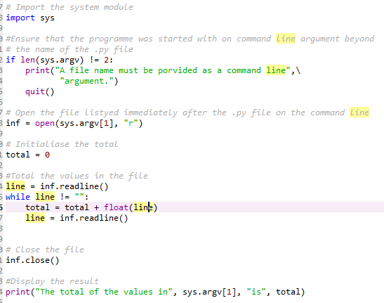
Command Line Arguments
Command line arguments can be used to supply any input values to the programme that can be typed on the command line such as integers, floating-point numbers, and strings

Slide 13

Exceptions
An exception is an error detected while a program is running. If it is not handled, the program usually stops. For example, a user can supply a non-numeric value when a numeric value is expected.
By default, a Python programme will crash when an exception occurs.
So, the programmer must indicate where an exception might occur in order to catch it.
The programmer must also indicate what code to run to handle the exception when it happens.
Try and except are used.
The code that might cause an exception that we want to catch is placed inside the try block
The try block is immediately followed by one or more except blocks.
When an exception occurs inside a try block, execution immediately jumps to the appropriate except block without running any remaining statements in the try block.
An except block without a specified exception type will catch almost any exception raised in the corresponding try block. However, it is usually better to catch specific exceptions where possible.
The except block only executes when an exception occurs.

Slide 14
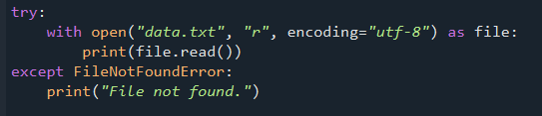
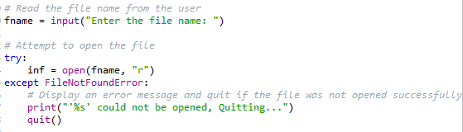
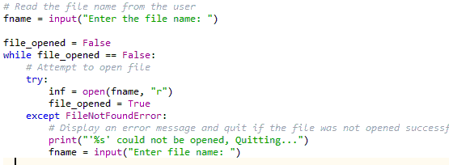
Exceptions example code
Quits when the file requested by the user is not found which is not always ideal.
A user can re-enter the name of the file. However this can also cause an exception. A loop is used to run until the user enters the name of the file successfully. The try and except are inside the loop

